Slide 1
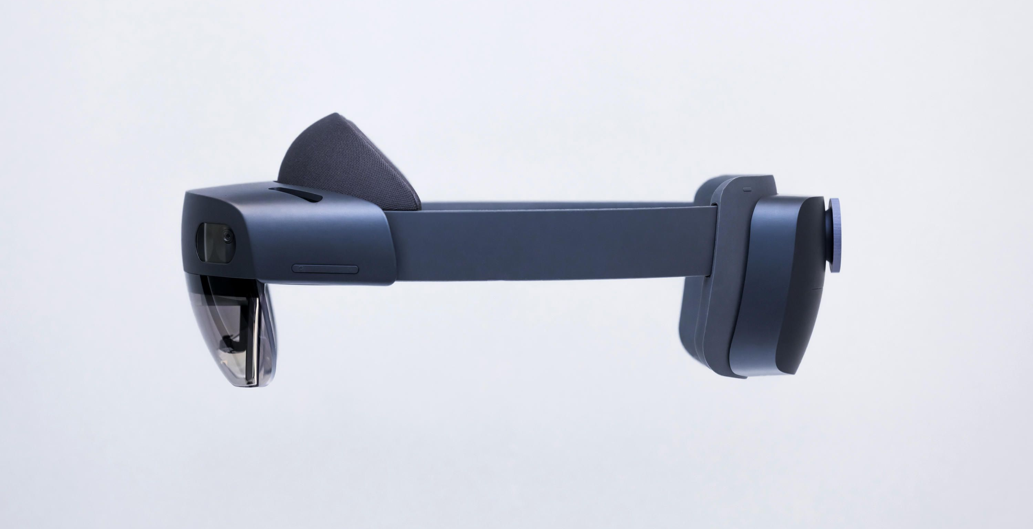
“It’s just code” A new approach to AI programming
Notes:
“It’s just code” – a new approach to machine learning frameworks?
Abstract:
The Julia language has a slogan about numerical computing: “it’s just code”. Applied to machine learning frameworks, this is basically saying that we don’t need them. You write the inference code, and the machine trains it using standard compiler technologies. They’ve shown this working in targeting GPUs, TPUs, and of course CPUs, and yet, Julia’s main ML framework looks kinda like Keras. I’ll talk about how it’s supposed to work, how it works today, and how it might work in the future. This isn’t just about Julia though. The “it’s just code” philosophy potentially applies in a variety of languages, and I want to get feedback from you on where *you* think we want to be in the next wave of ML programming.

Slide 2
The AI Programming Landscape
New mathematical models
Learning algorithms on data structures
trees, graphs, 3D shapes
not just WxHxCxBxN “tensors”
Recursion
Data-dependent flow control
New hardware
TPU, IPU, HPU, CPU
Not just fast for WxH blocks of values
New people
“Regular devs”, not just ninjas
Who need to implement, finetune, retrain, weak

Slide 3
AI programming tools, a brief history
Gen 1: 1995-2012 | Gen 2: 2007-2018 | Gen 3: 2018
Custom code handwritten for convolution, “backprop”, everything… | Computation graphs with automatic gradient computation and GPU acceleration | “It’s just code”
MATLAB/C++/CUDA | Theano/TensorFlow/PyTorch | Julia/F#/...
Changed the world | Changed the world again | Changed the world back
But only for ninjas | Good for ninjas, not bad for PhDs | Great for ninjas, good for everyone

Slide 4
Numerical Computing in CV/ML
“Classical 3D Computer Vision”
Lots of small matrices (3x4, 12x27)
E.g. Kinect body tracking, HoloLens head and hand tracking
“Classical machine learning”
Ridge regression, linear regression
Gaussian mixture models, K-means
Not numeric: random forests/trees
“[Classical] Deep learning”
Large matrix/vector ops, memory movement.
“Efficient/Edge deep learning”
Movidius, HPU, etc: small matrix/vector ops.

Slide 5
It’s just code

Slide 6
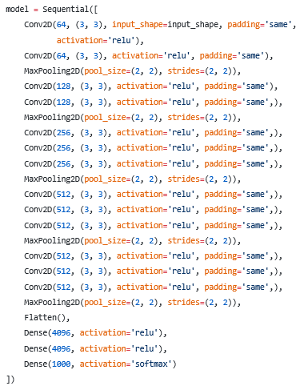
State of the Art Today
Clunky DSLs: TensorFlow, PyTorch
Fast for large problems (training)
Slow for inference
Great languages: Julia, Python, F#
“It’s just code”
Links to DSLs for training
Slow for inference

Slide 7
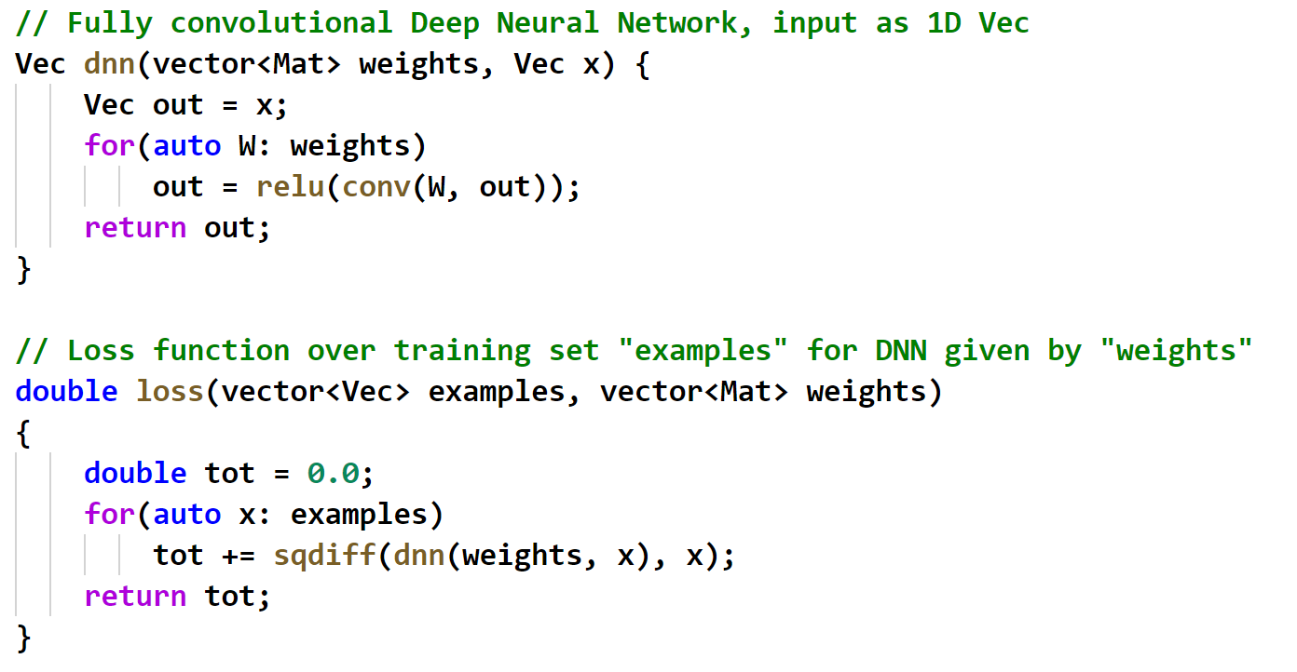
Deep learning 101

Slide 8
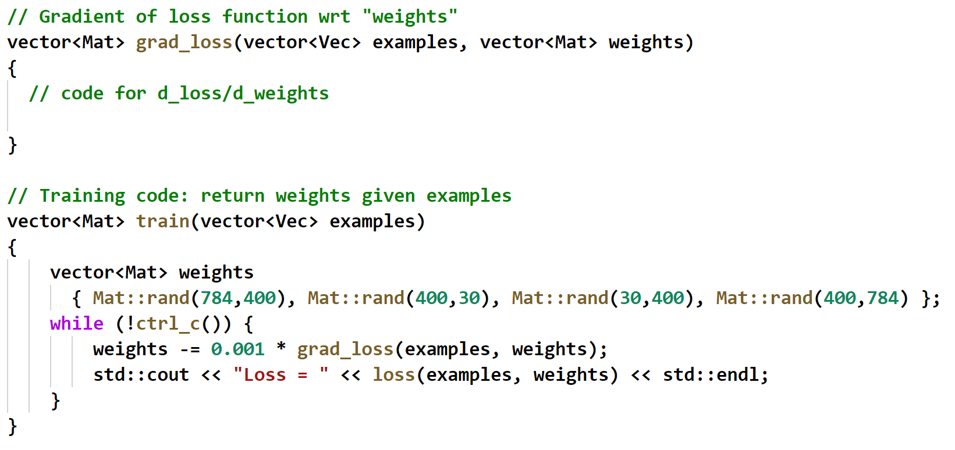
Deep learning 101: Training

Slide 9

Deep learning 101: Training

Slide 10
Deep learning 101: Training

Slide 11
State of the Art Today
Clunky DSLs: TensorFlow, PyTorch
Fast for large problems (training)
Slow for inference
Great languages: Julia, Python, F#
“It’s just code”
Links to DSLs for training
Slow for inference

Slide 12
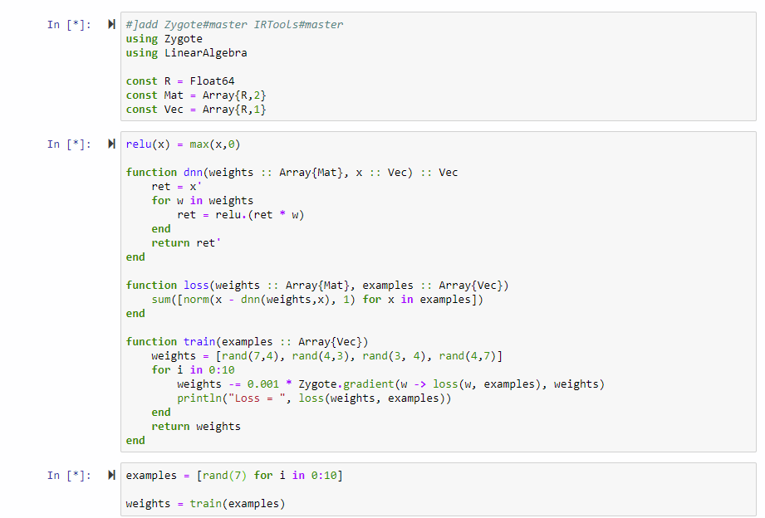
State of the Art Today
Clunky DSLs: TensorFlow, PyTorch
Fast for large problems (training)
Slow for inference
Great languages: Julia, Python, F#
“It’s just code”
Links to DSLs for training
Slow for inference

Slide 13
State of the Art Today
Clunky DSLs: TensorFlow, PyTorch
Fast for large problems (training)
Slow for inference
Great languages: Julia, Python, F#
“It’s just code”
Links to DSLs for training
Slow for inference

Slide 14
“It’s just code”: VGG16
A real-world, complicated model

Slide 15
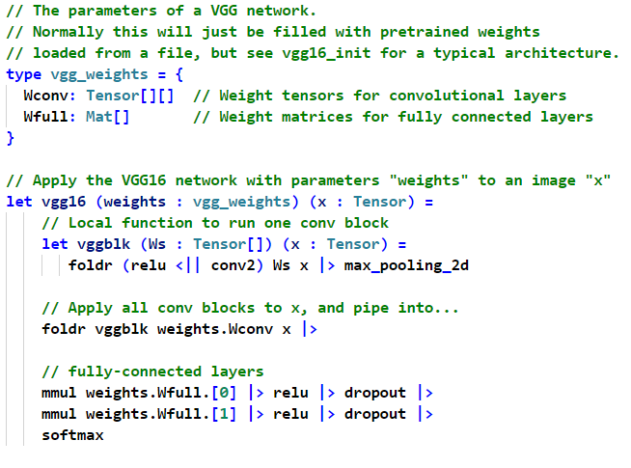

Slide 16
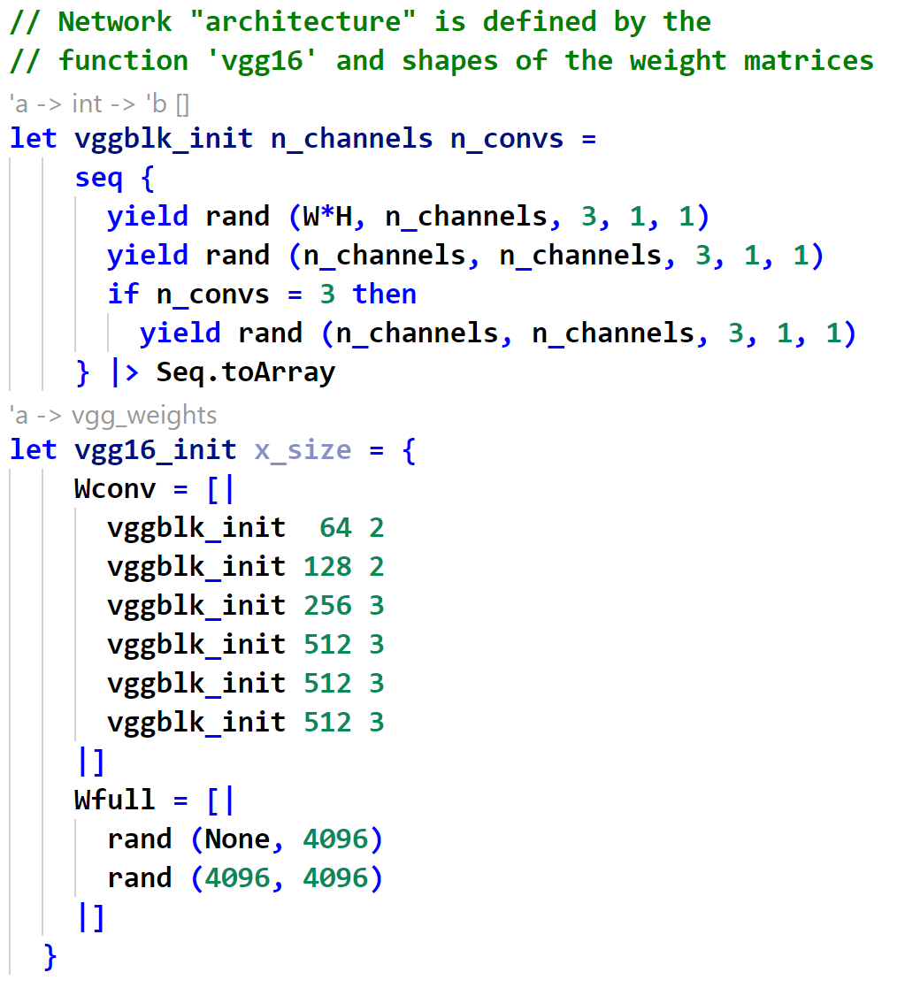

Slide 17
A developer’s story
I’m Andy.
I work for Gnome.co.uk. Not the Linux GNOME, actual garden gnomes. We also do spare parts for sundials. Ask me why. Actually don’t.
I work mostly in ASP.NET / C#, front end, back end, middle end, midden end.
The boss wants a new feature where customers can upload their gnome pics and we’ll classify them into 10 types. You know: Forest, River, Svirfneblin, Chaos, Ice, Sky, Rock, Paper, Scissors….
And.. I know exactly what to do. The boss said her friend said “Rip the head off a vgg16 and then finetune it to your gnomes”. Right. Still, better get started.
A little later. I’ve got the training data. 10000 lovingly labelled gnome images, cost us 500 quid to recruit some experts at the local Warhammer store.

Slide 18
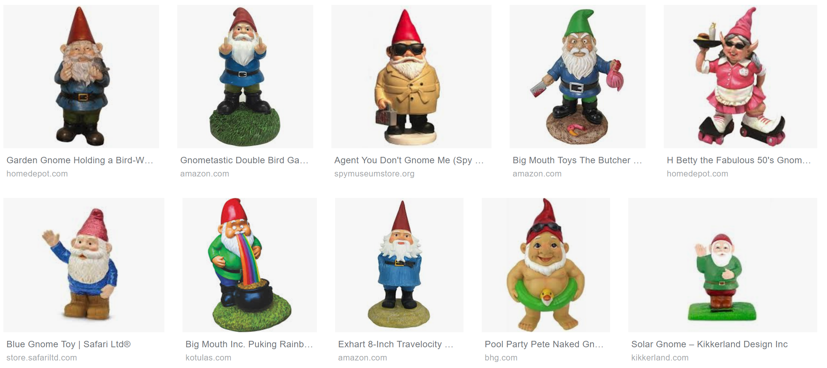

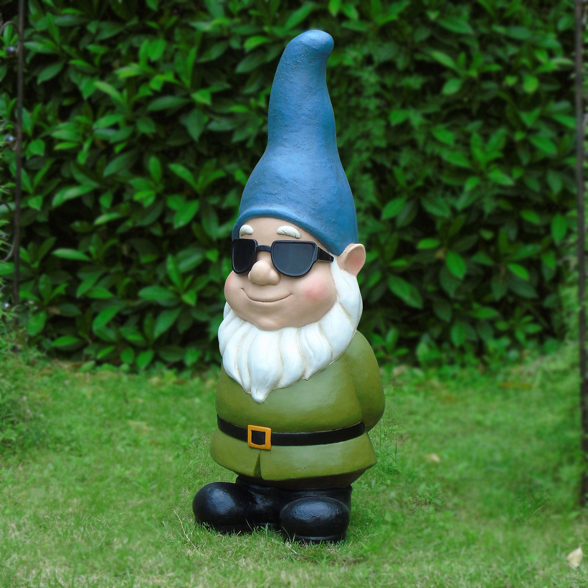


Training data
Rock
Sky
Svirfneblin
Sky
Chaos
Sky
Chaos
Sky
River
Chaos

Slide 19
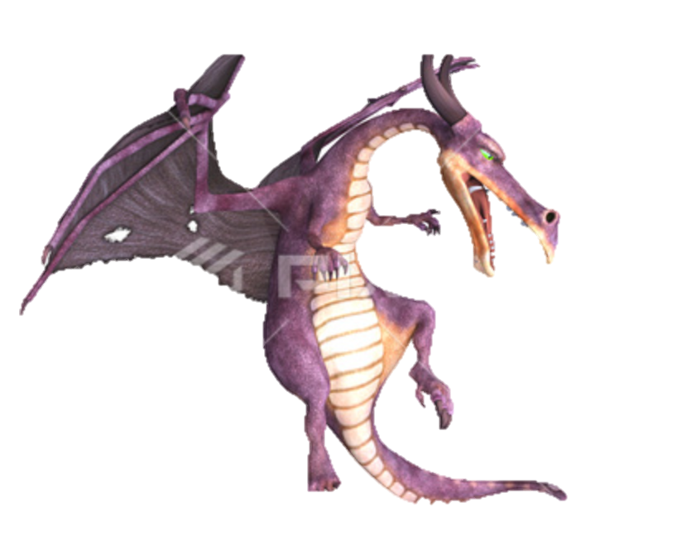
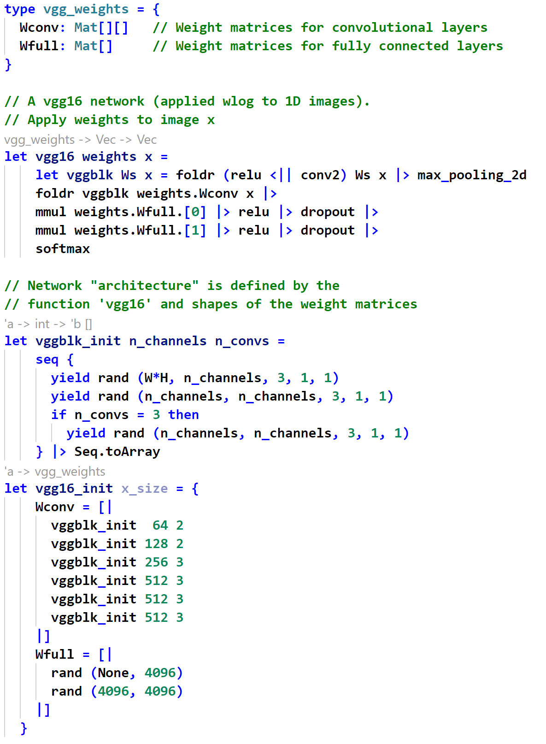
Now, “Rip the head off a vgg16”. Hmm.
Well, I could start by getting a vgg16 whatever that is.
I drop this so-called model “vgg16.fs” into my project. It's weird that it's just one file.
Let’s point the object browser at it and see what's in it…
vgg16.fs

Slide 20
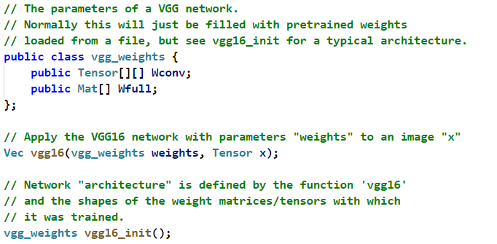
Now, “Rip the head off a vgg16”. Hmm.
Well, I could start by getting a vgg16 whatever that is.
I drop this so-called model “vgg16.fs” into my project. It's weird that it's just one file.
Let’s point the object browser at it and see what's in it…
vgg16.fs

Slide 21
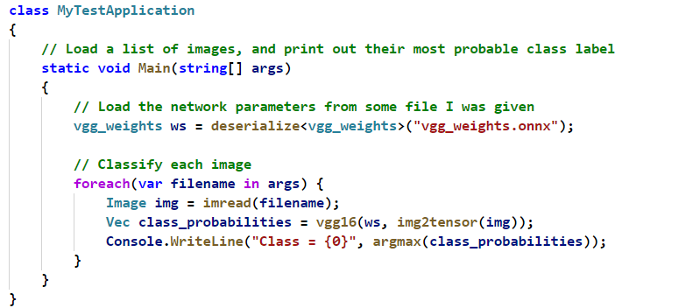
Dropping in an OTS (off-the-shelf) vgg16, calling seamlessly from C#
I drop this so-called model “vgg16.fs” into my project. It's weird that it's just one file, let's look at the object browser and see what's in it…
I know it only does cats and stuff, but let’s just get that working.
OK, carefully folllowing the sample, I can now write my user code like this:
OK, run it, give it my cat image. It prints 17! Is that good?
Oh look, the onnx file came with a file called “vgg_weights.class_labels.json”
Let’s look in that:
{"0": "tench“, "1": "goldfish", "2": "great_white_shark"… “17”: “cat” … ]
Wooohoo! 17 is cat! Look at me and my AI app!
But the boss wants me to classify our 10 different types of gnome. I wonder how many are in the JSON file?
Search for g..gn... gno… gnom… no hits. They have the hognose_snake for gno, but no gnomes at all!
Notes:
A developer's story (Web view)

Slide 22
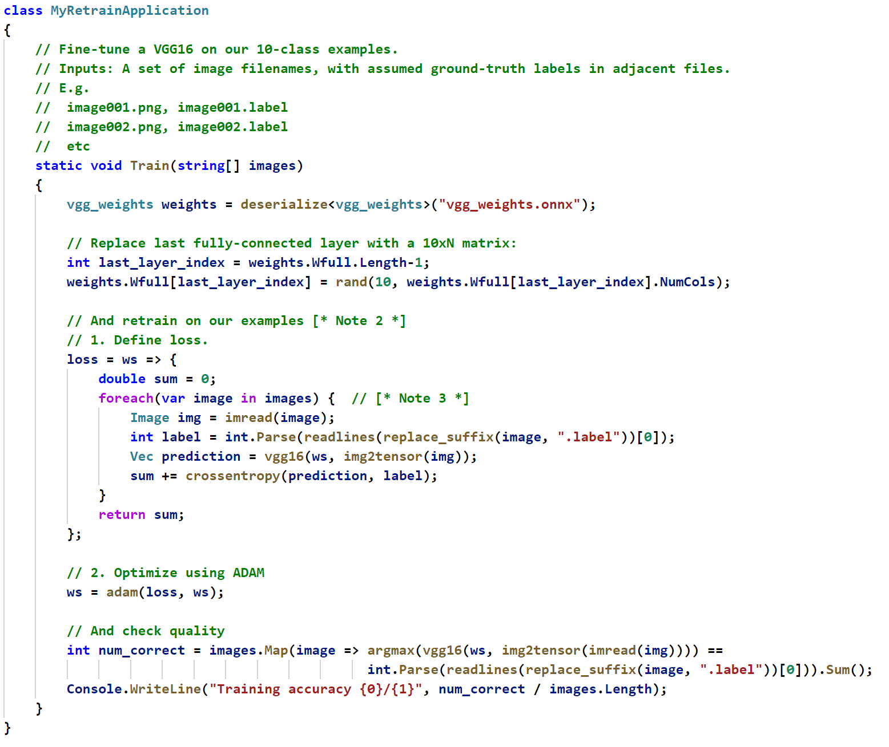
Repurposing an OTS classifier to recognize my own training images, only doing 10 classes
Alex, my AI expert friend, said I should replace the last fully connected layer in Wfull with a 10-label layer and retrain…
OK. I am brave. And she did say pretty much exactly what to do.

Slide 23
3. OK, but then Jody told me “vgg16 is overkill for this”, and I could “slim down a couple of conv blocks.”
Now I do need to edit vgg16.fs.
EWWWW. But I am brave.
vgg16.fs

Slide 24
3. OK, but then Jody told me “vgg16 is overkill for this”, and I could “slim down a couple of conv blocks.”
Now I do need to edit vgg16.fs.
EWWWW. But I am brave.
Oh, there’s that stuff I saw in vgg16.cs, and there’s the definition of vgg16, that function I called.
There’s even a “conv block”, but I don’t see how to “slim it”.
Let’s page down…

Slide 25
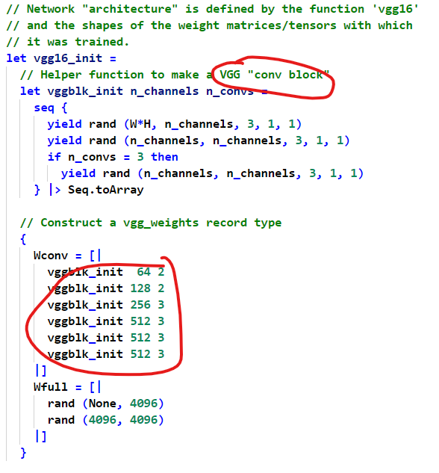
3. OK, but then Jody told me “vgg16 is overkill for this”, and I could “slim down a couple of conv blocks.”
Now I do need to edit vgg16.fs.
EWWWW. But I am brave.
Oh, there’s that stuff I saw in vgg16.cs, and there’s the definition of vgg16, that function I called.
There’s even a “conv block”, but I don’t see how to “slim it”.
Let’s page down…

Slide 26
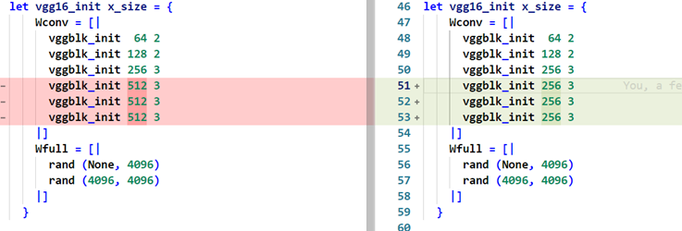
Aha! I see blocks. Let’s “slim some down….”. Whatever that might mean.
Cross fingers, recompile, re-train, re-run.
Wow, quite a bit faster.
And what?! accuracy went up!!!
… by 0.01%, probably random luck …
… but who cares, I am machine learning megagod!
Check. This. Baby. In.

Slide 27
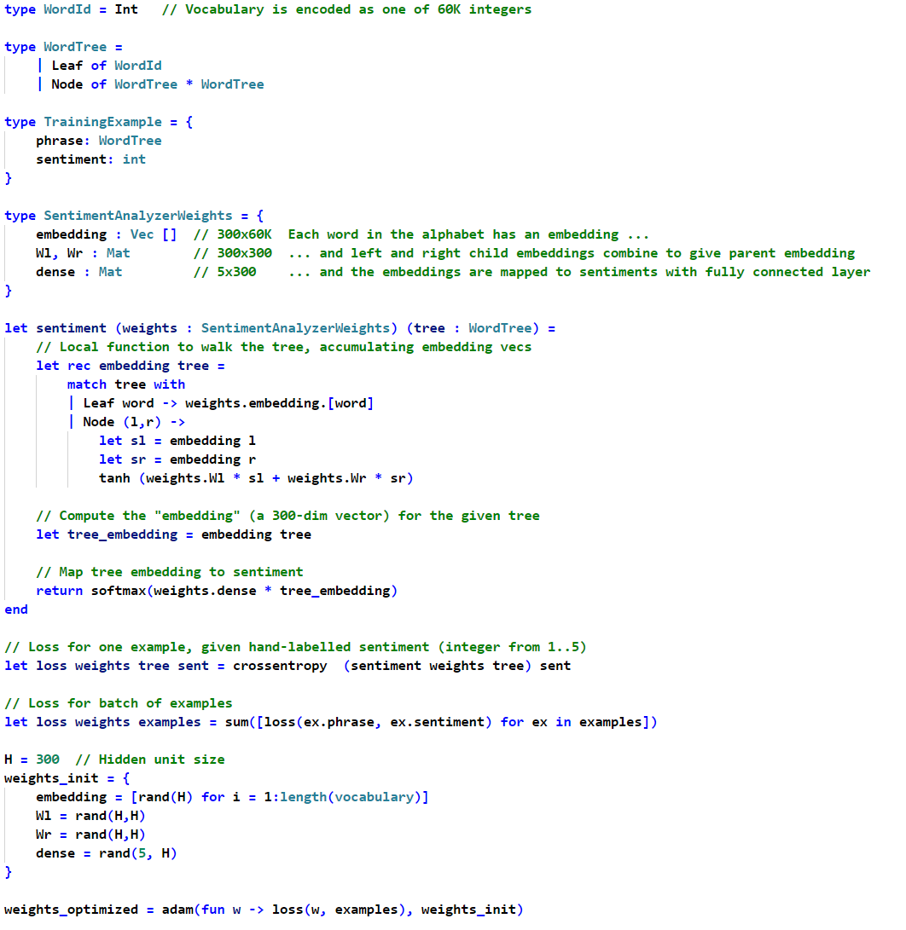
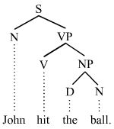
And now for something really complicated….

Slide 28
So, what’s my story?
Deep learning is a whole lot easier to understand if you just think of it as code
And it’s a whole lot easier to write sophisticated DL models if it’s just code
Great, so when can I use it?
Maybe June if all goes well…

Slide 29
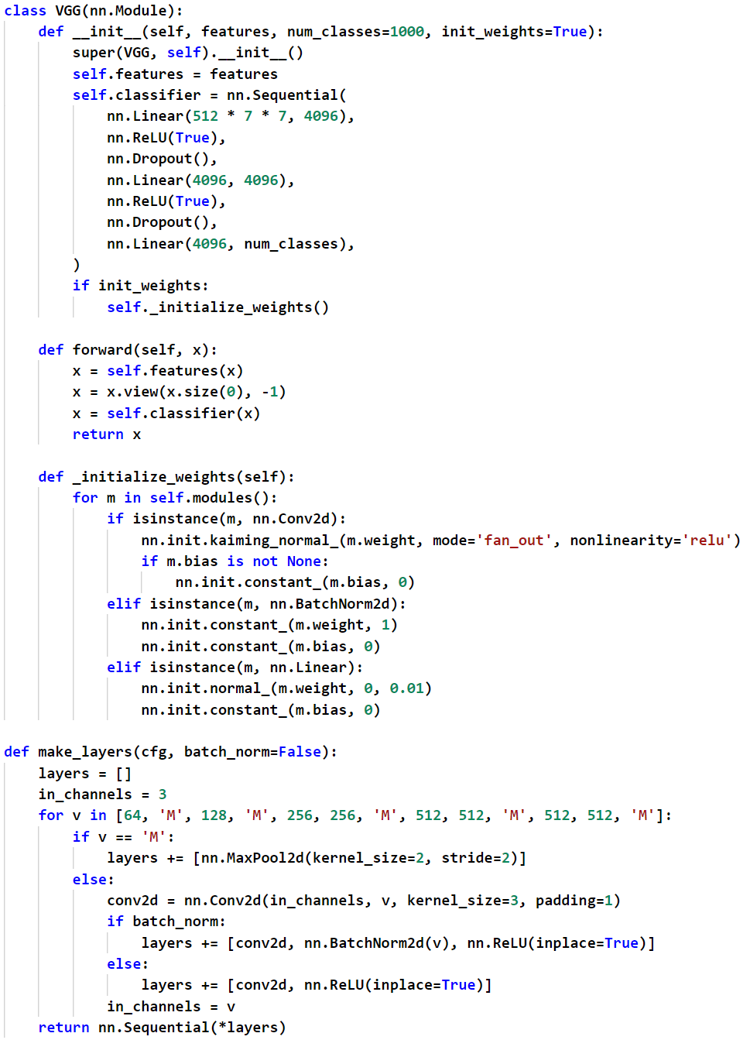
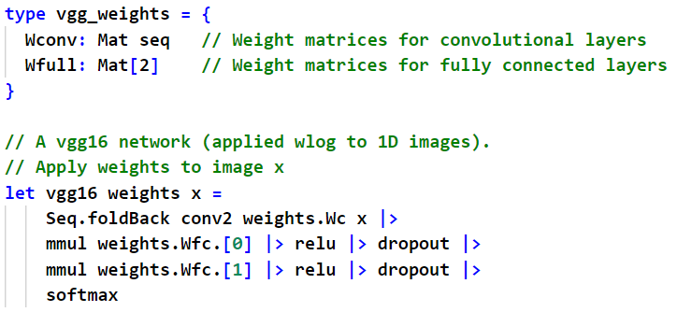
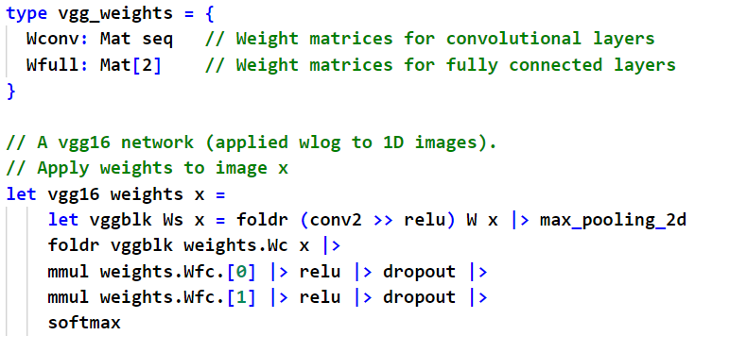
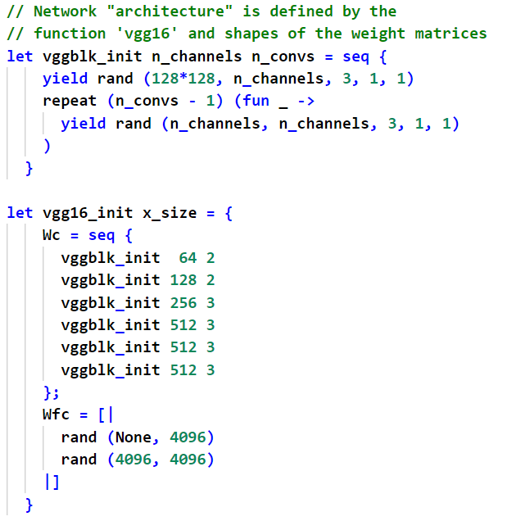
Deep learning: VGG16 today (Keras/PyTorch/etc)
Notes:
https://github.com/pytorch/vision/blob/f87a896f170a34502a60cdc358c19d8b55e72f54/torchvision/models/vgg.py

Slide 30
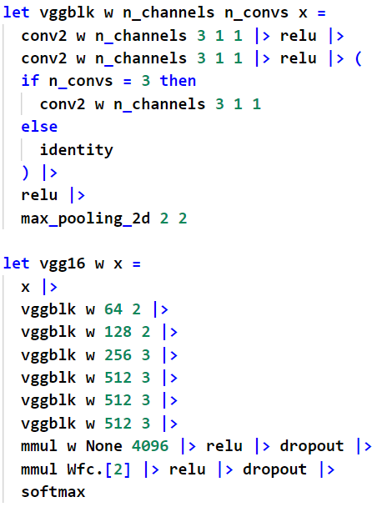
Deep learning: VGG16 for geeks
Notes:
https://github.com/pytorch/vision/blob/f87a896f170a34502a60cdc358c19d8b55e72f54/torchvision/models/vgg.py

Slide 31
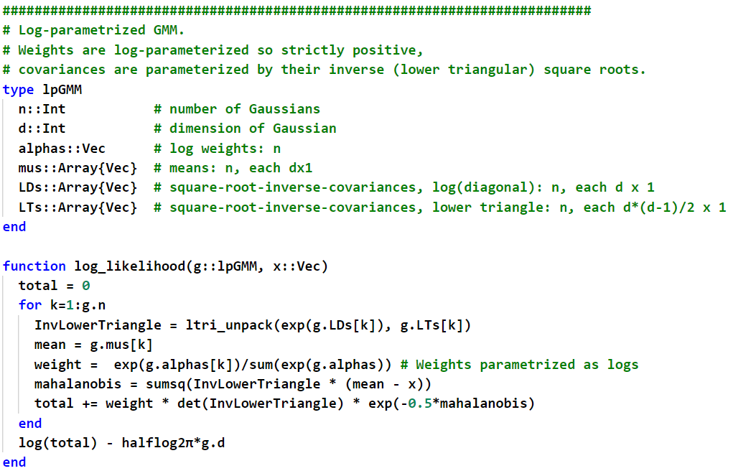
Example: GMM (Gaussian Mixture Model)

Slide 32
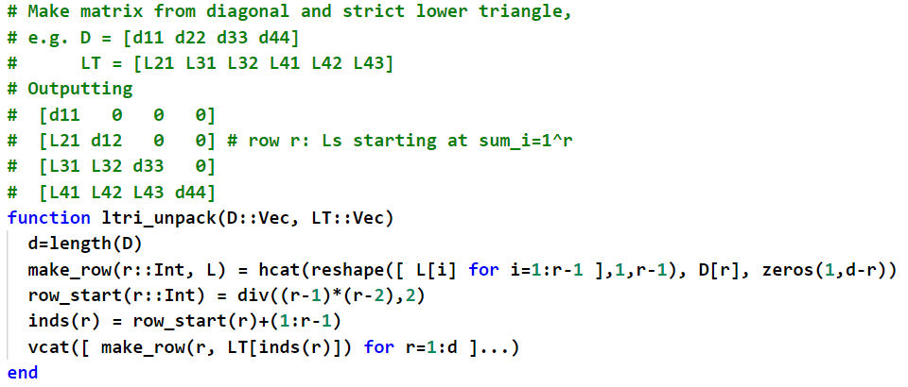
Example: GMM (Gaussian Mixture Model)

Slide 33
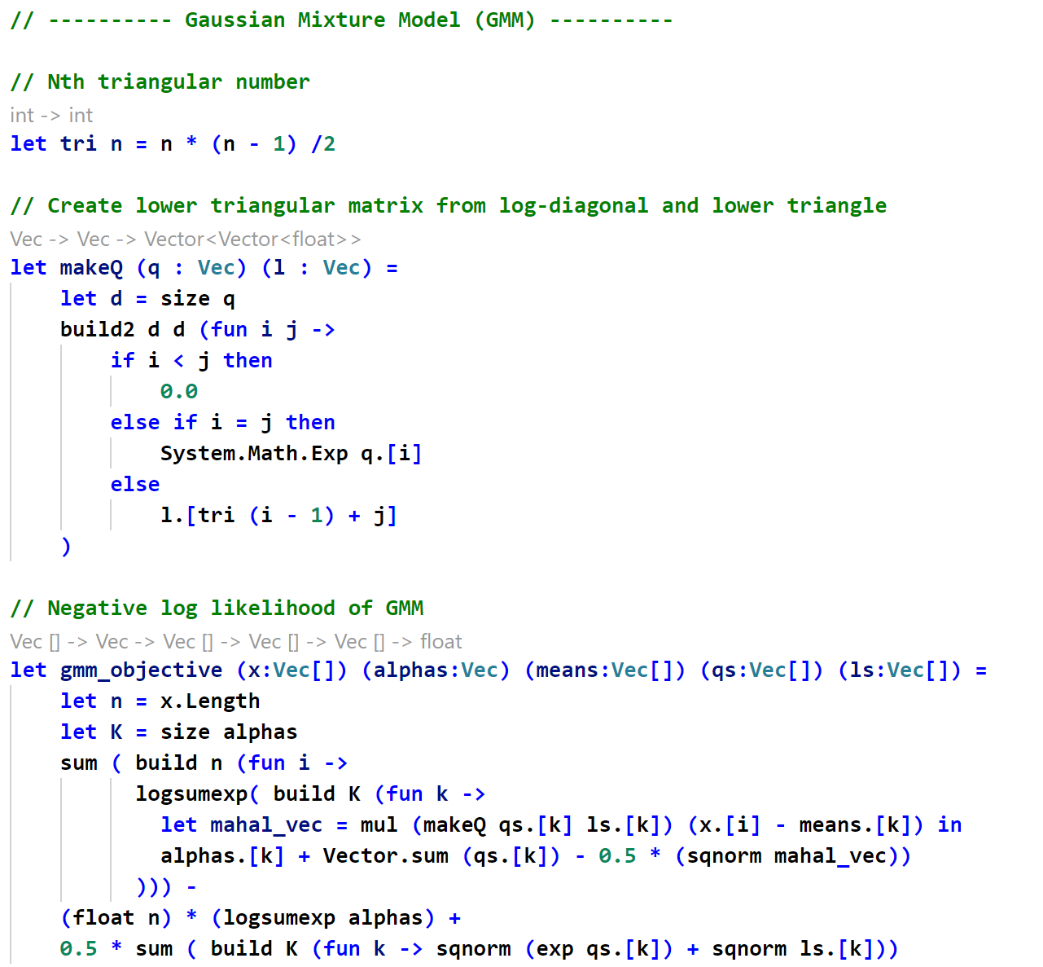

Slide 34
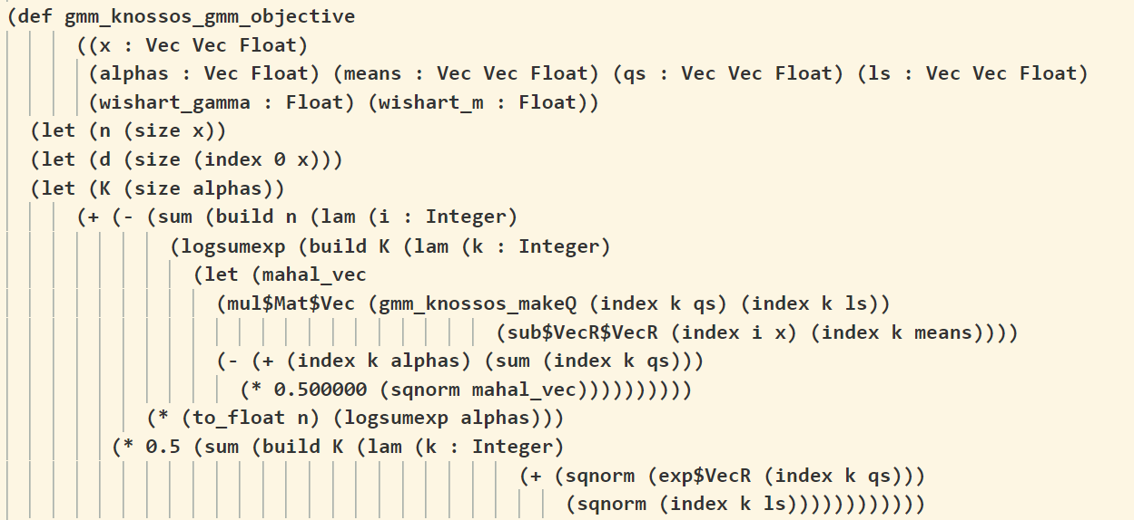

Slide 35
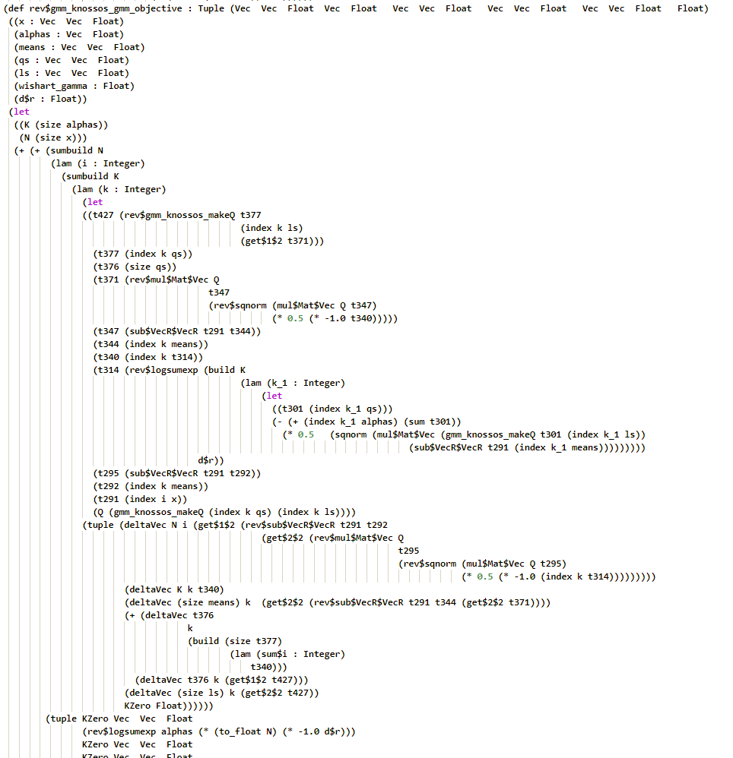

Slide 36
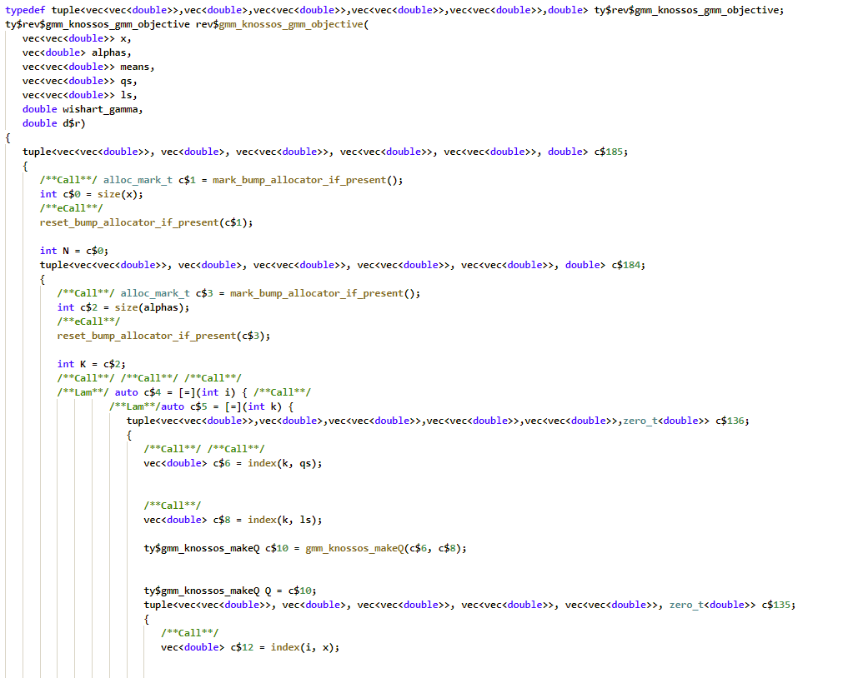

Slide 39
Wrap up
I believe in a “Gen3” machine learning/AI framework, which is “just code”
I know how to deliver it from F#, probably from Julia, maybe from C#/Python
If you’re interested in seeing more at any time, just get in touch.

Slide 40
Tapenade

Slide 41
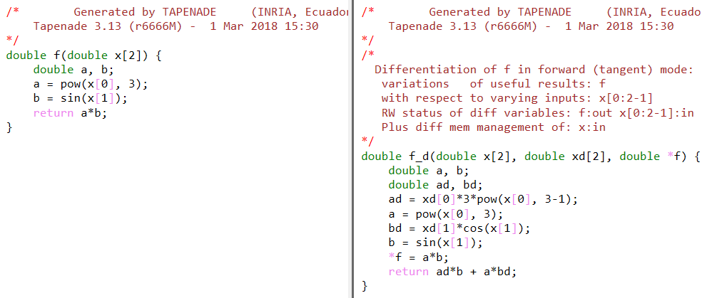
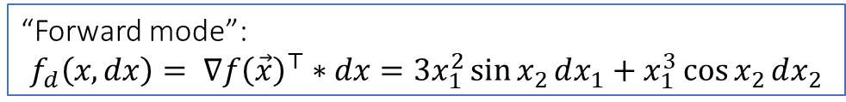
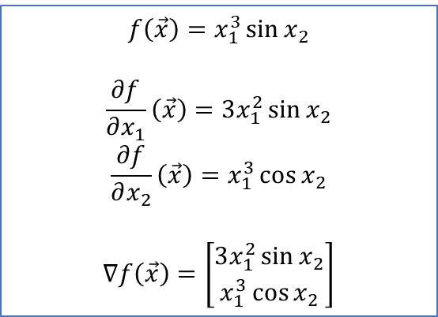
Automatic differentiation is code transformation
$$f\left(\vec{x}\right)=x_{1}^{3}\sin{x_{2}}$$
$$\frac{∂f}{∂x_{1}}\left(\vec{x}\right)=3x_{1}^{2}\sin{x_{2}}$$
$$\frac{∂f}{∂x_{2}}\left(\vec{x}\right)=x_{1}^{3}\cos{x_{2}}$$
$$∇f\left(\vec{x}\right)=\left[\begin{aligned}3x_{1}^{2}\sin{x_{2}} \\ x_{1}^{3}\cos{x_{2}}\end{aligned}\right]$$
“Forward mode”:
$$f_{d}\left(x, dx\right)= ∇f{\left(\vec{x}\right)}^{⊤}∗dx=3x_{1}^{2}\sin{x_{2}}dx_{1}+x_{1}^{3}\cos{x_{2}}dx_{2}$$
Notes:
double f(double x[2])
{
double a,b;
a = pow(x[0],3);
b = sin(x[1]);
return a * b;
}

Slide 42
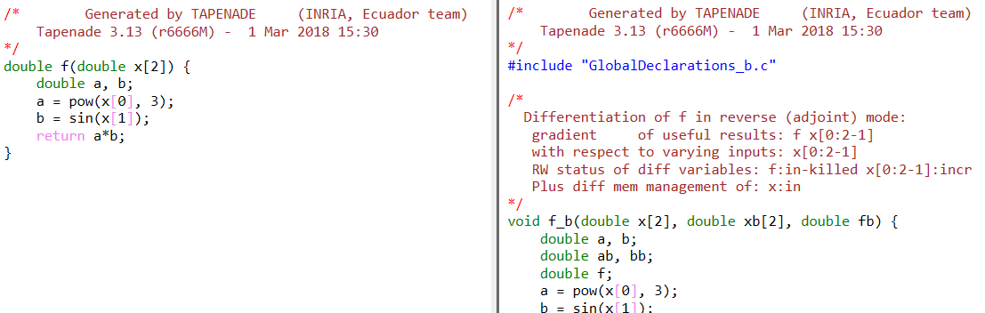
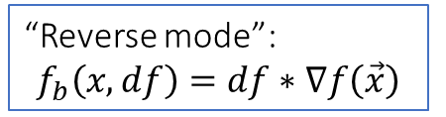
Automatic differentiation is code transformation
$$f\left(\vec{x}\right)=x_{1}^{3}\sin{x_{2}}$$
$$\frac{∂f}{∂x_{1}}\left(\vec{x}\right)=3x_{1}^{2}\sin{x_{2}}$$
$$\frac{∂f}{∂x_{2}}\left(\vec{x}\right)=x_{1}^{3}\cos{x_{2}}$$
$$∇f\left(\vec{x}\right)=\left[\begin{aligned}3x_{1}^{2}\sin{x_{2}} \\ x_{1}^{3}\cos{x_{2}}\end{aligned}\right]$$
“Reverse mode”:
$$f_{b}\left(x, df\right)=df∗∇f\left(\vec{x}\right)$$
Notes:
double f(double x[2])
{
double a,b;
a = pow(x[0],3);
b = sin(x[1]);
return a * b;
}

Slide 43
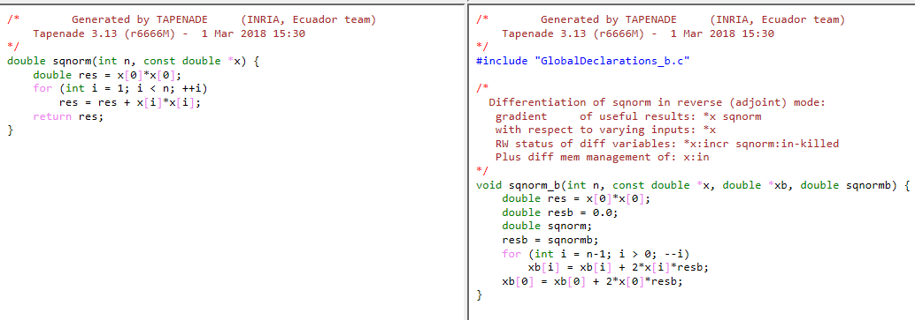
Loops work fine…

Slide 44
Some optimization is tricky
Often called with sqnormb = 1.0

Slide 45
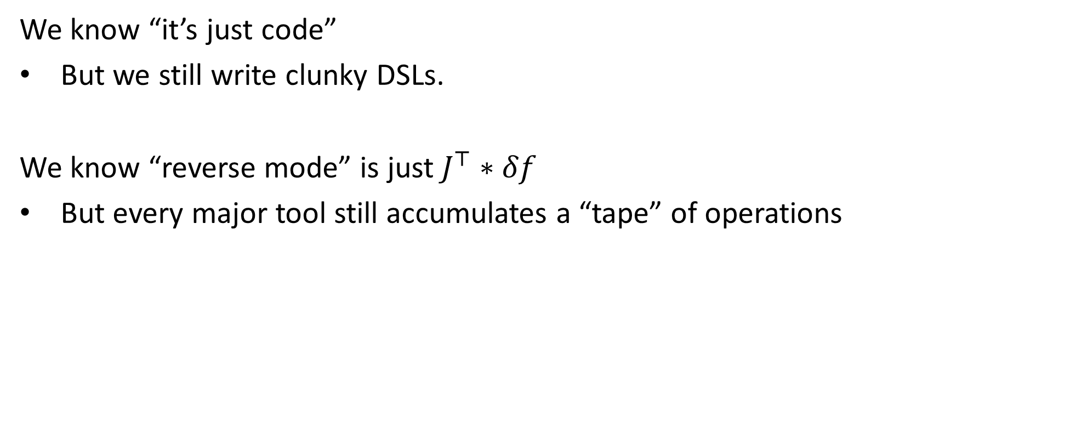
So where are we
We know “it’s just code”
But we still write clunky DSLs.
We know “reverse mode” is just $J^{⊤}∗δf$
But every major tool still accumulates a “tape” of operations

Slide 46
What can you do
Take a toolkit in your favourite language, and make it “just code”….
F#: DiffSharp, make Hype “just code”
ML: OWL
Julia: Zygote, make FluxML “just code”
C++,Haskell,Go,Rust: Just make one… ☺
Python,Java,C#: unmatched pattern

